Slide 1

Guilherme Duarte, 107766
André Rodrigues, 108412
João Rodrigues, 108214
IHC- Assignment 2
Lab Class P4
1
Notes:
1

Slide 2
Contextualization
Introduction
A ridesharing APP where the users can offer and request rides.
Motivation
We are personally interested in a platform like this, since we are not from Aveiro, and we need to use public transports which have frequent delays or strikes.
2
Notes:
Sharing rides can make transportation more affordable and accessible for everyone.

Slide 3
Project Objectives
Goals
Benefits
Facilitate Ridesharing​
Encourage Community Cooperation​
Encourage Sustainability
Cheaper Travels​
Meet new people​
Reduce traffic congestion;​
Positive environmental impact;
3
Notes:
O principal objetivo é facilitar a partilha de boleias, tornando as mesmas numa opção prática e barata de chegar de um ponto a outro. Existe também o objetivo de incentivar o espírito de comunidade e cooperação, bem como aumentar a sustentabilidade dos transportes pessoais.

Slide 4

Personas
Name: Marco Silva
Age: 23
Profession: Master's Student in Mechanical Engineering​
Background: Marco is a master's student at the University of Aveiro, living in Aveiro during the week.
Motivation: Every weekend he needs to move from/to his hometown and wants to reduce the costs of his trips.
Objective: Add a ride
4

Slide 5

Personas
Name: Jokic Suns
Age: 22
Profession: Univerity Exchange Student
Background: Jokic is a Serbian student on exchange in Aveiro. He loves exploring new cultures and places.
Motivation: Wishes to explore portuguese cities and meet new people.
Objective: Find a ride
5

Slide 6
Usage Scenarios
Marco
Jokic
Share a ride​
Take a ride​
Needs to go to Coimbra (his hometown) in the weekend. ​
To reduce costs wants to share a ride with someone.
Wants to visit Coimbra and make new friends but isn't eager on taking the train alone.
6
Notes:
A ride can be great since its cheap and would be an adventure.

Slide 7
Summary of the requirements analysis
Non-functional requirements
Users' security
Language Support
Data Protection
Secure Payments
Ease of Use
Ease of Learning
Functional Requirements ​
Login / Signup​
Share/Add a Ride​
Search/Take a Ride​
Localization Access
Book and Cancel Rides​
Add profile info
In-App Messaging​
Ratings and Reviews​
Payment mechanism
7

Slide 8
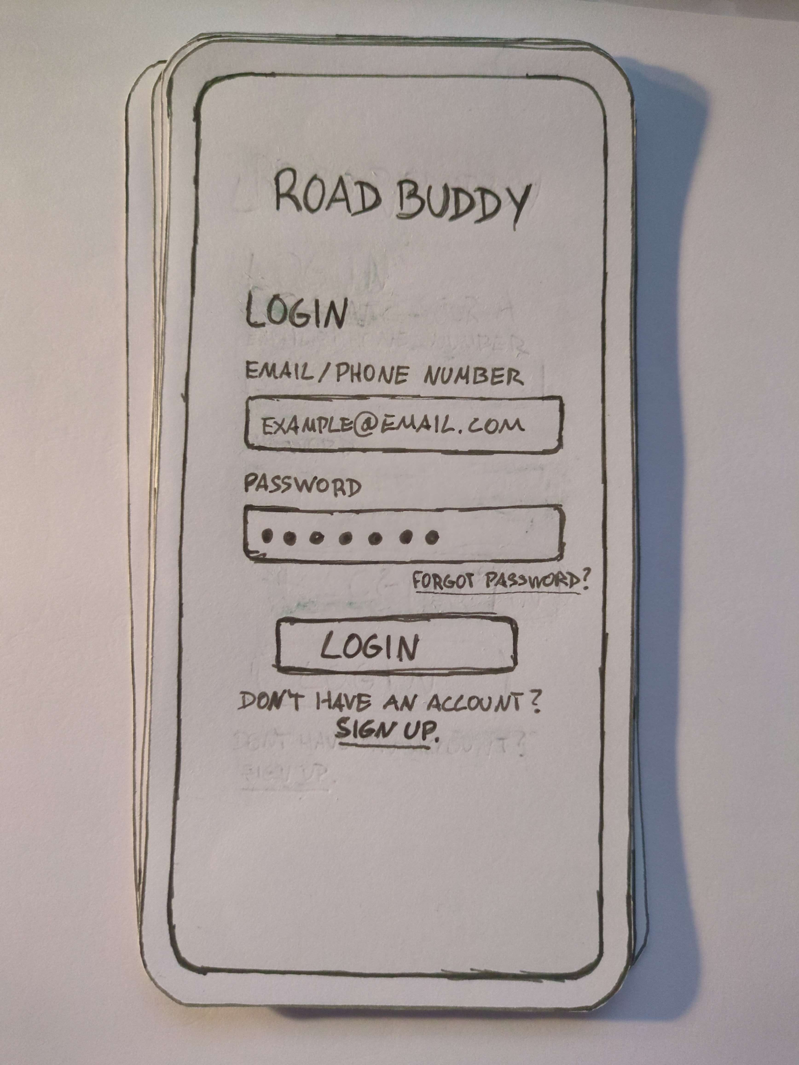
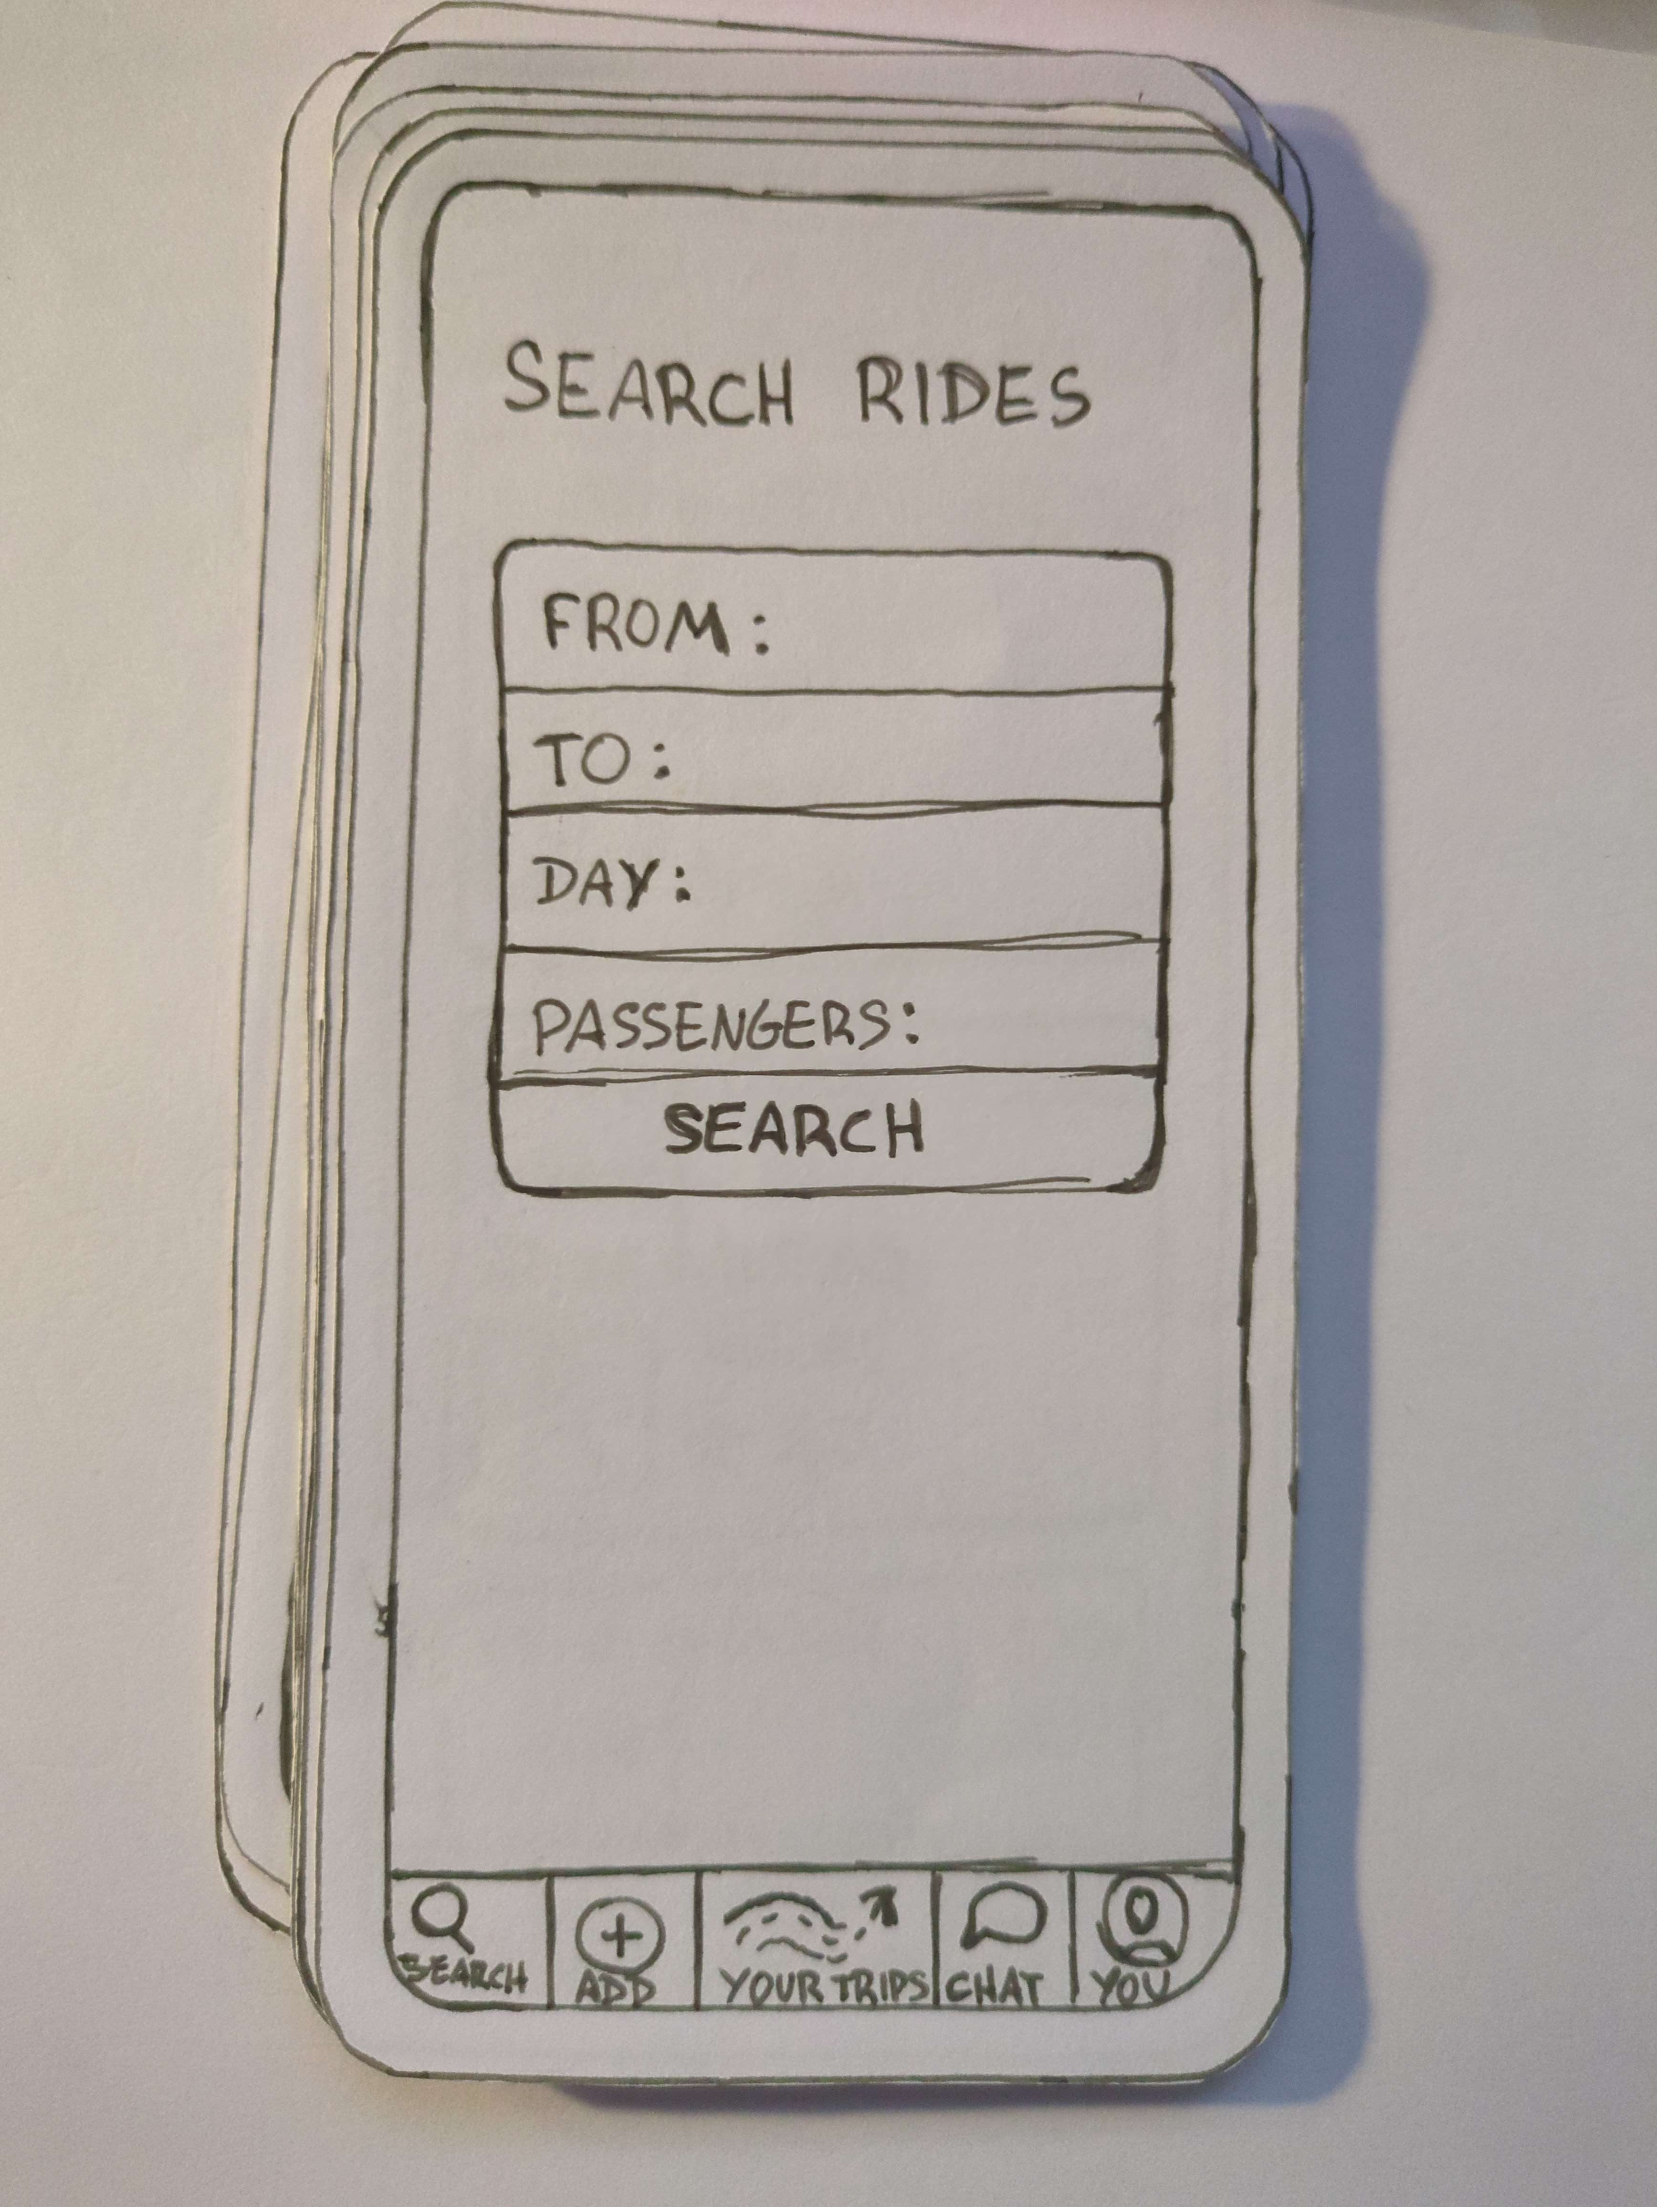
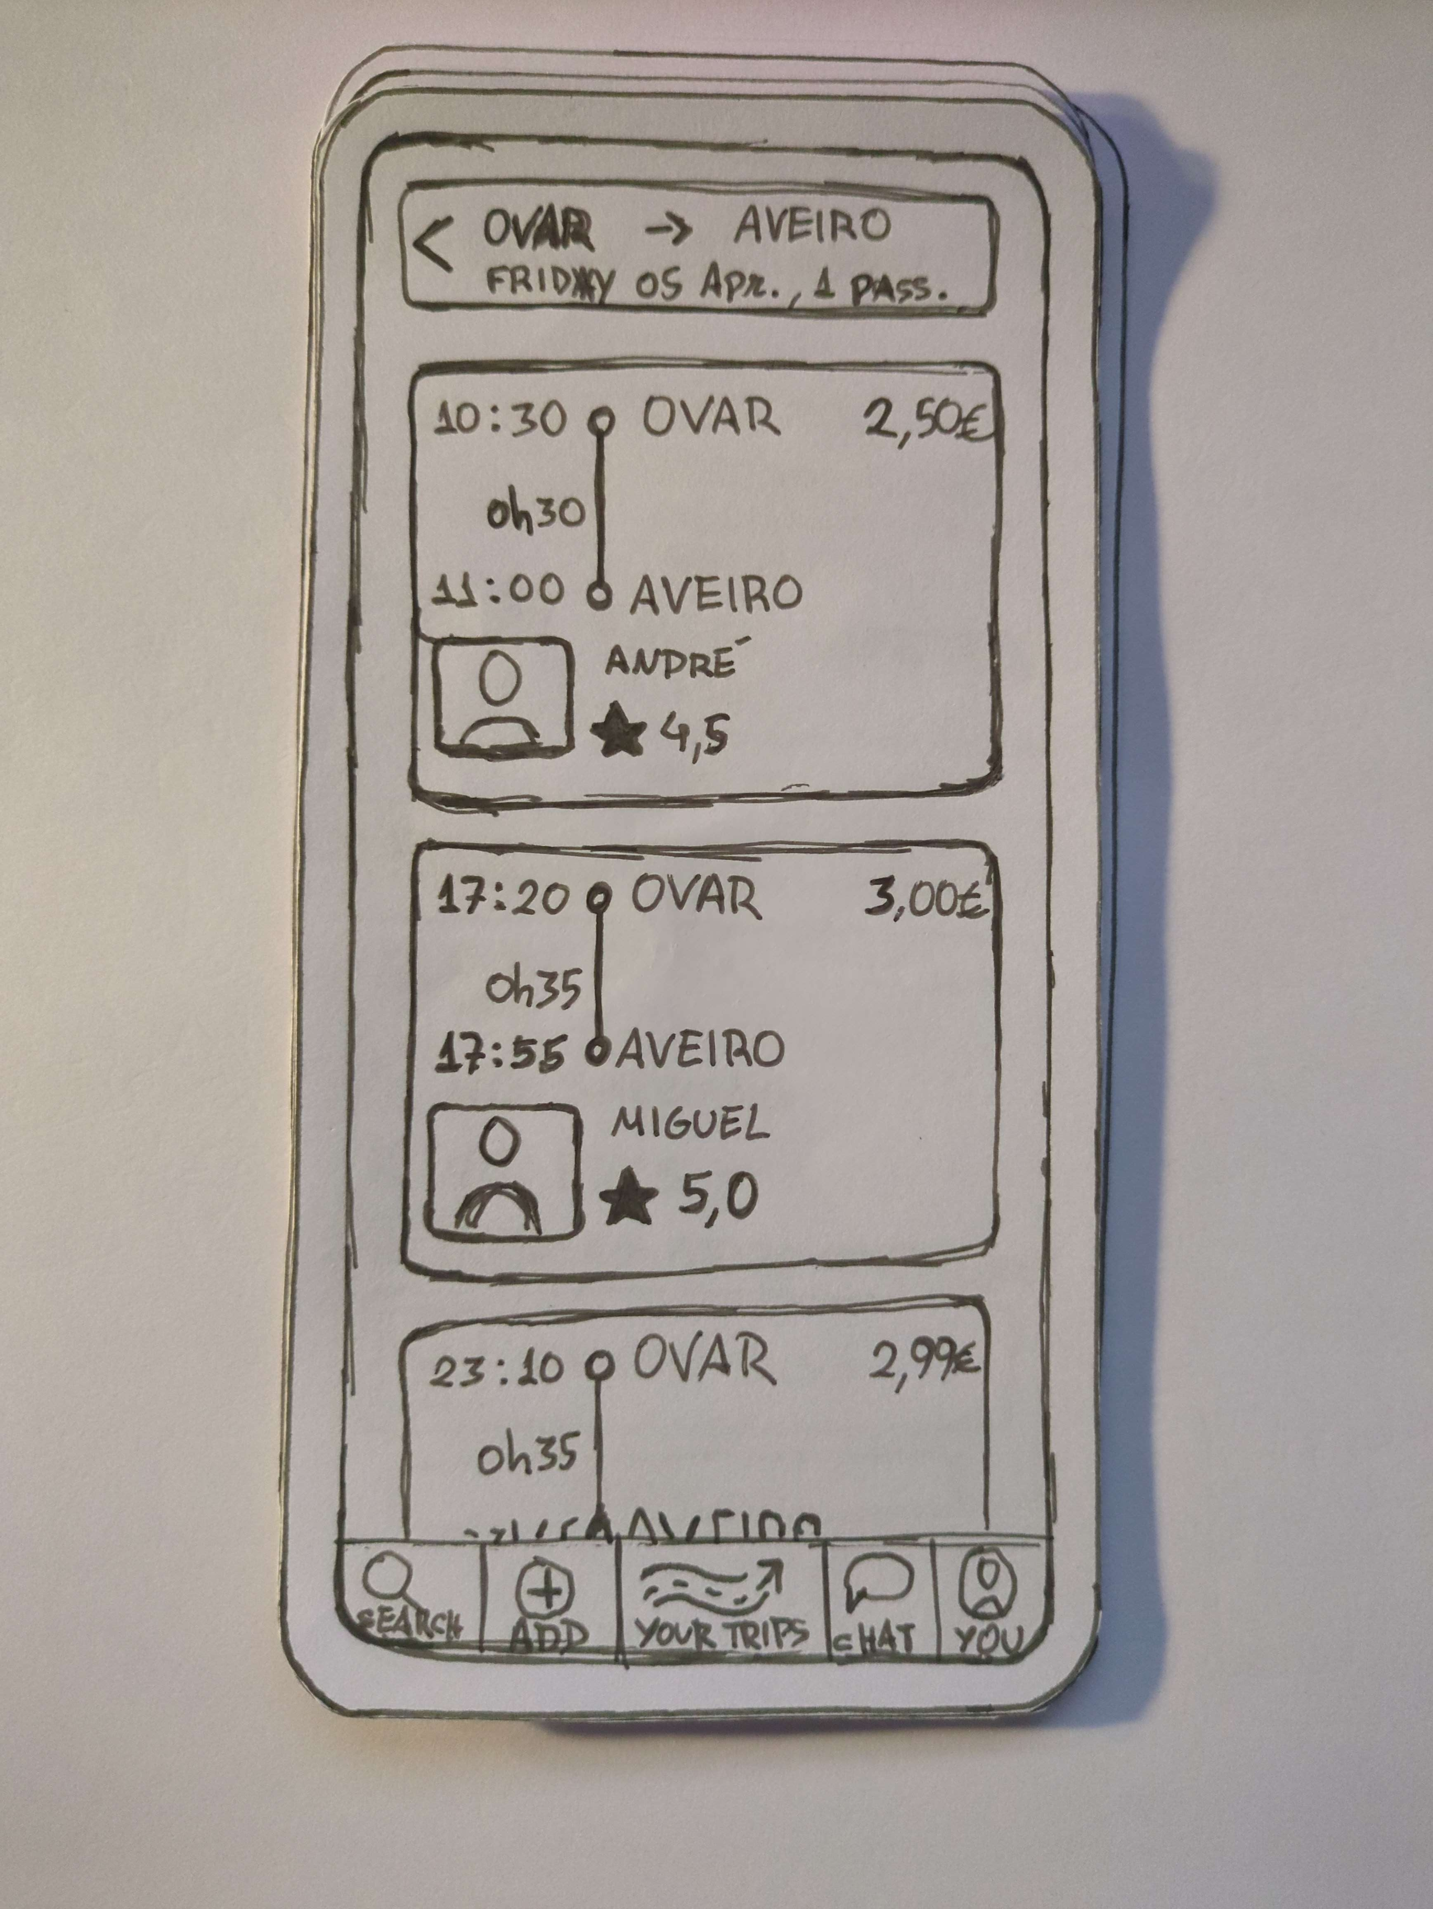
Paper prototype images
8

Slide 9
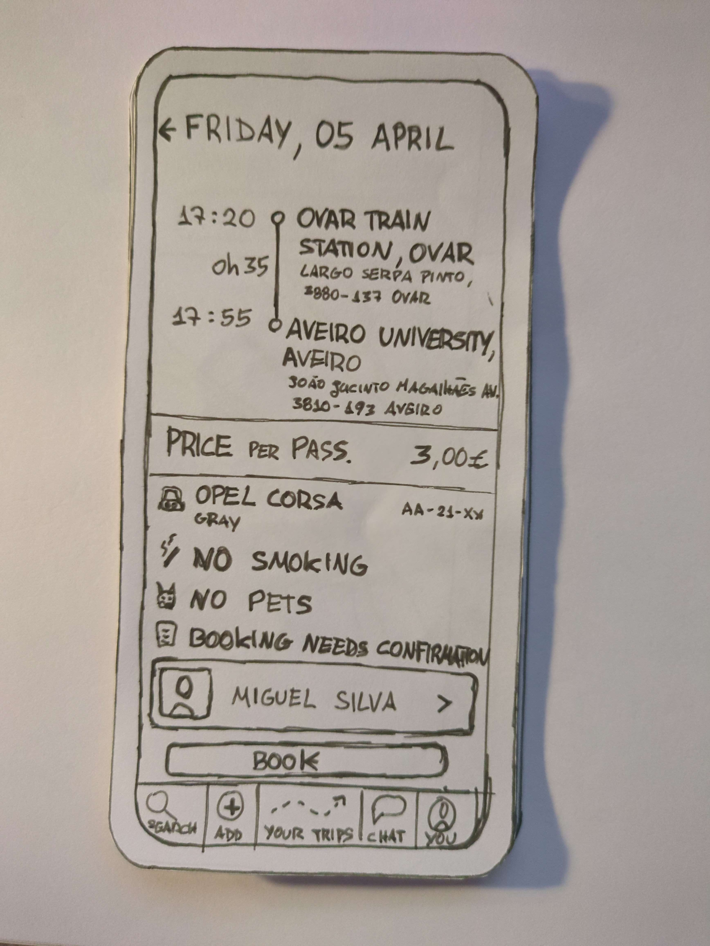
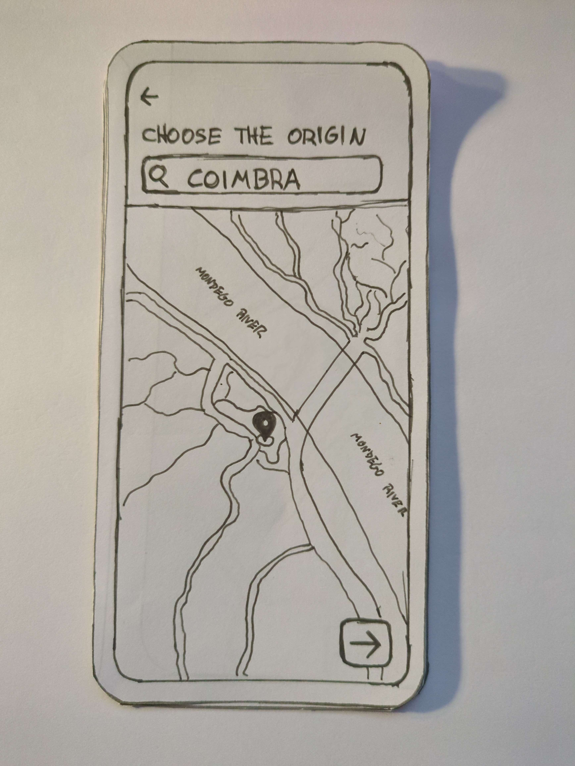
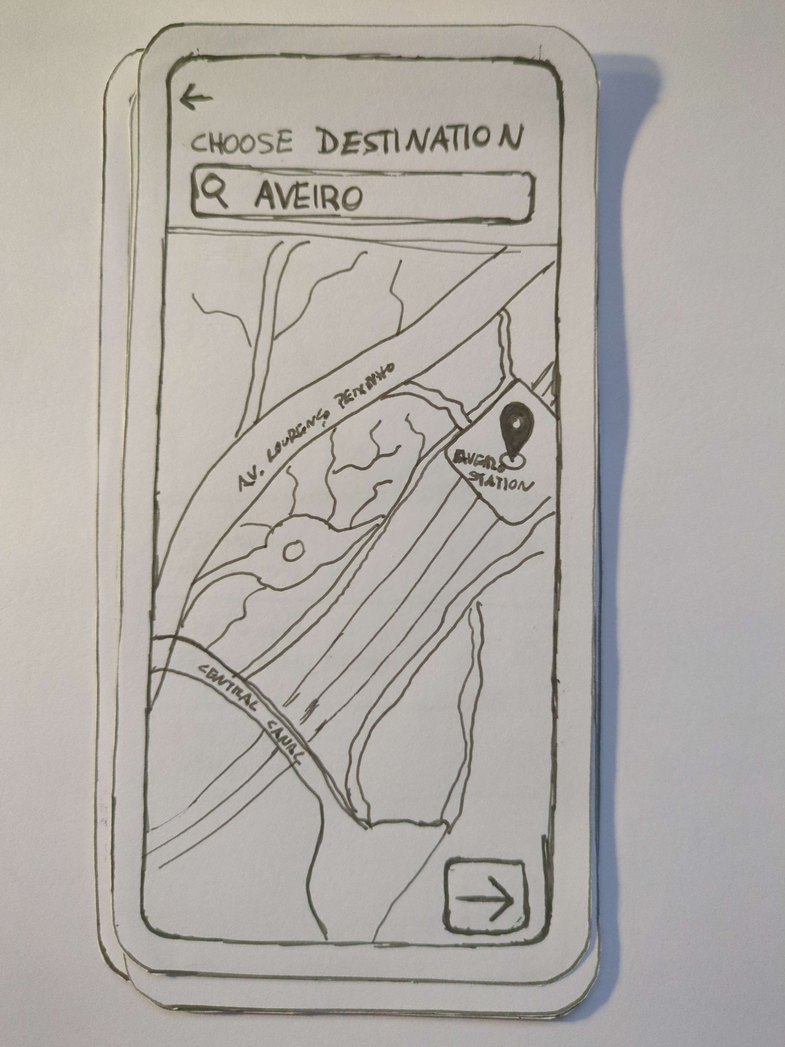
Paper prototype images
9

Slide 10
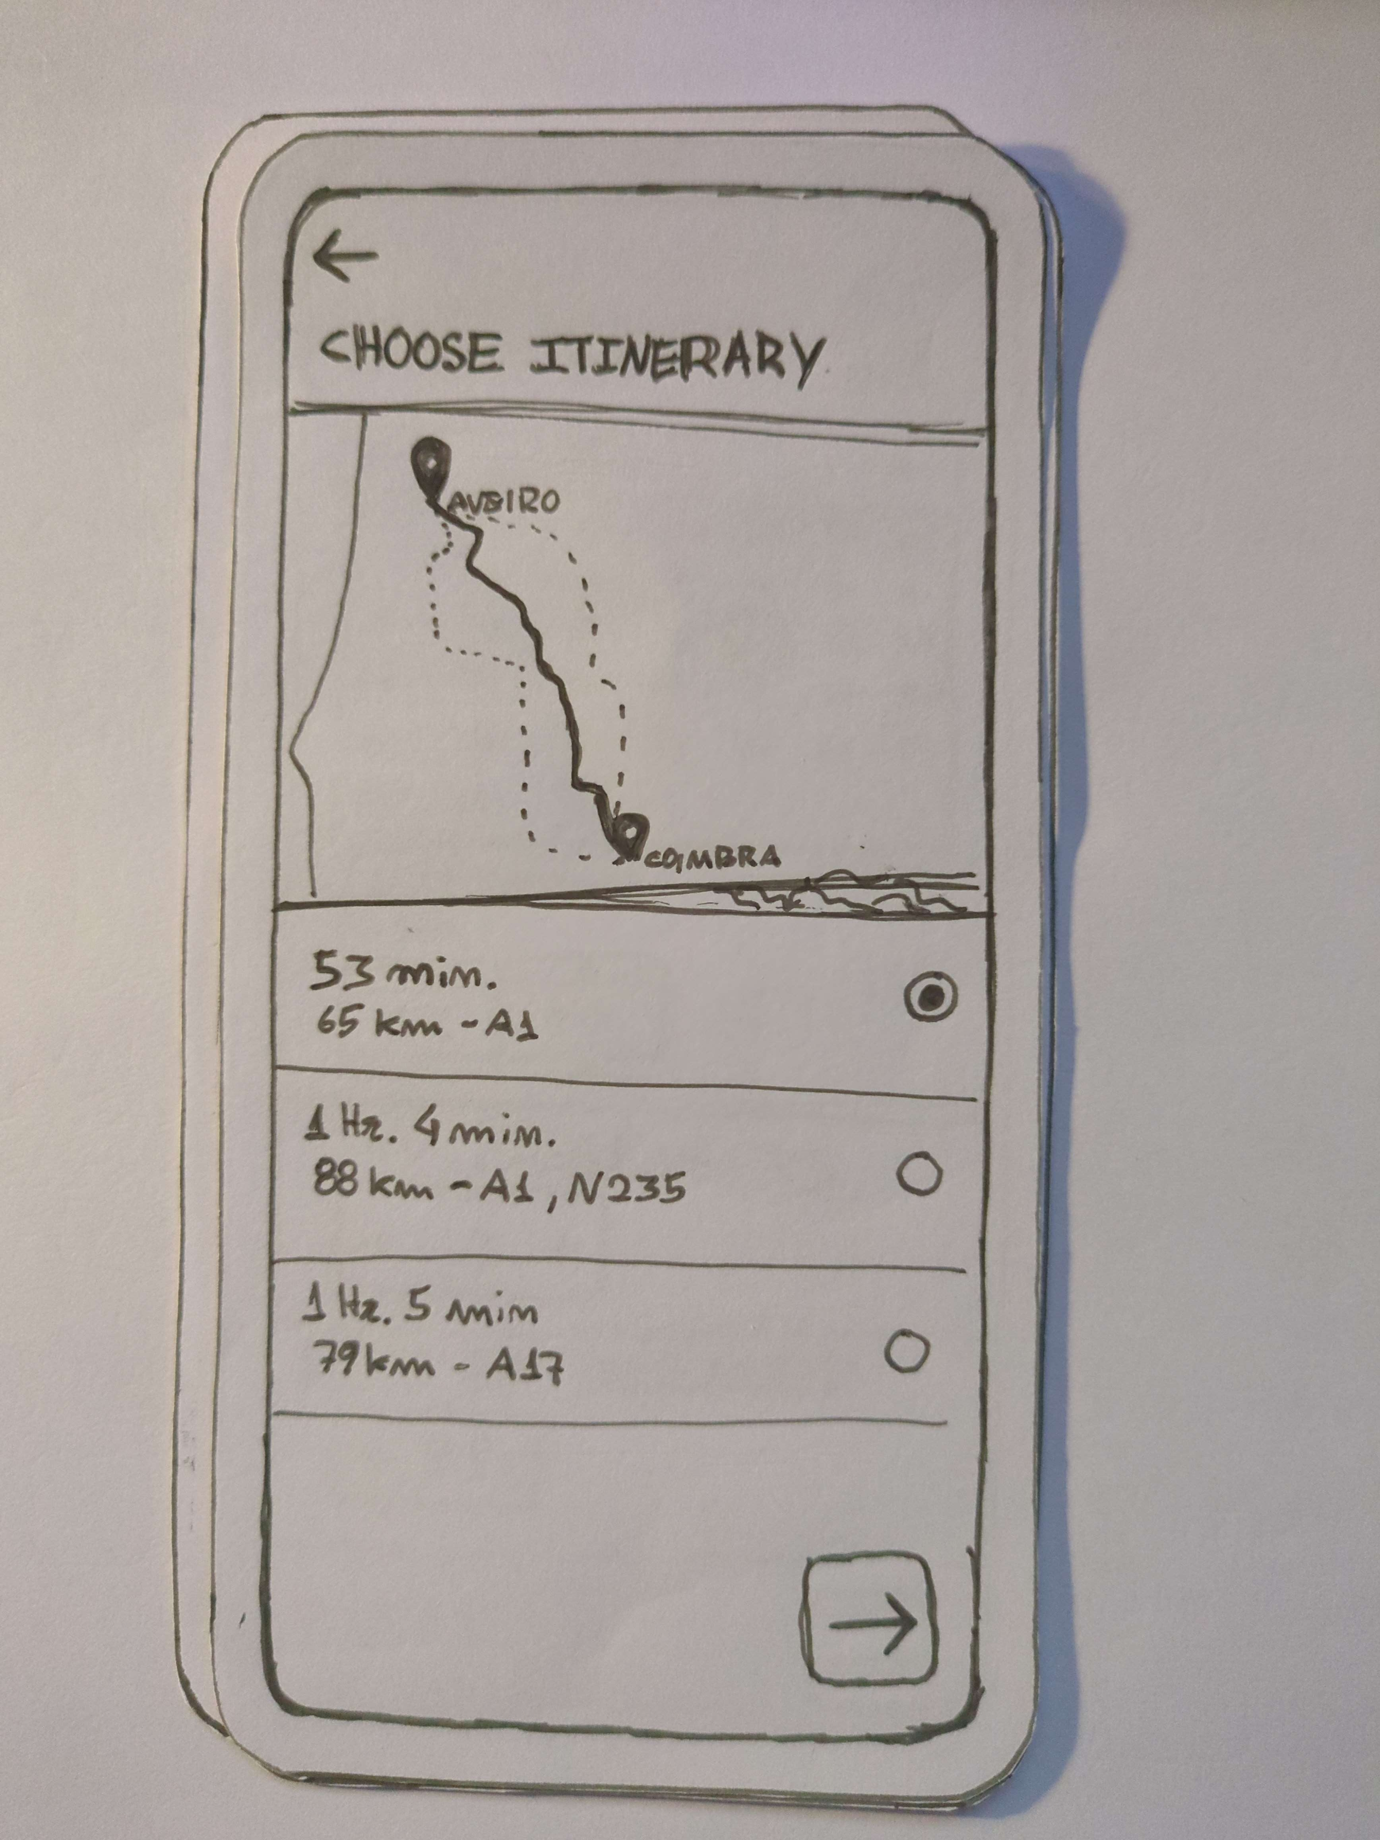
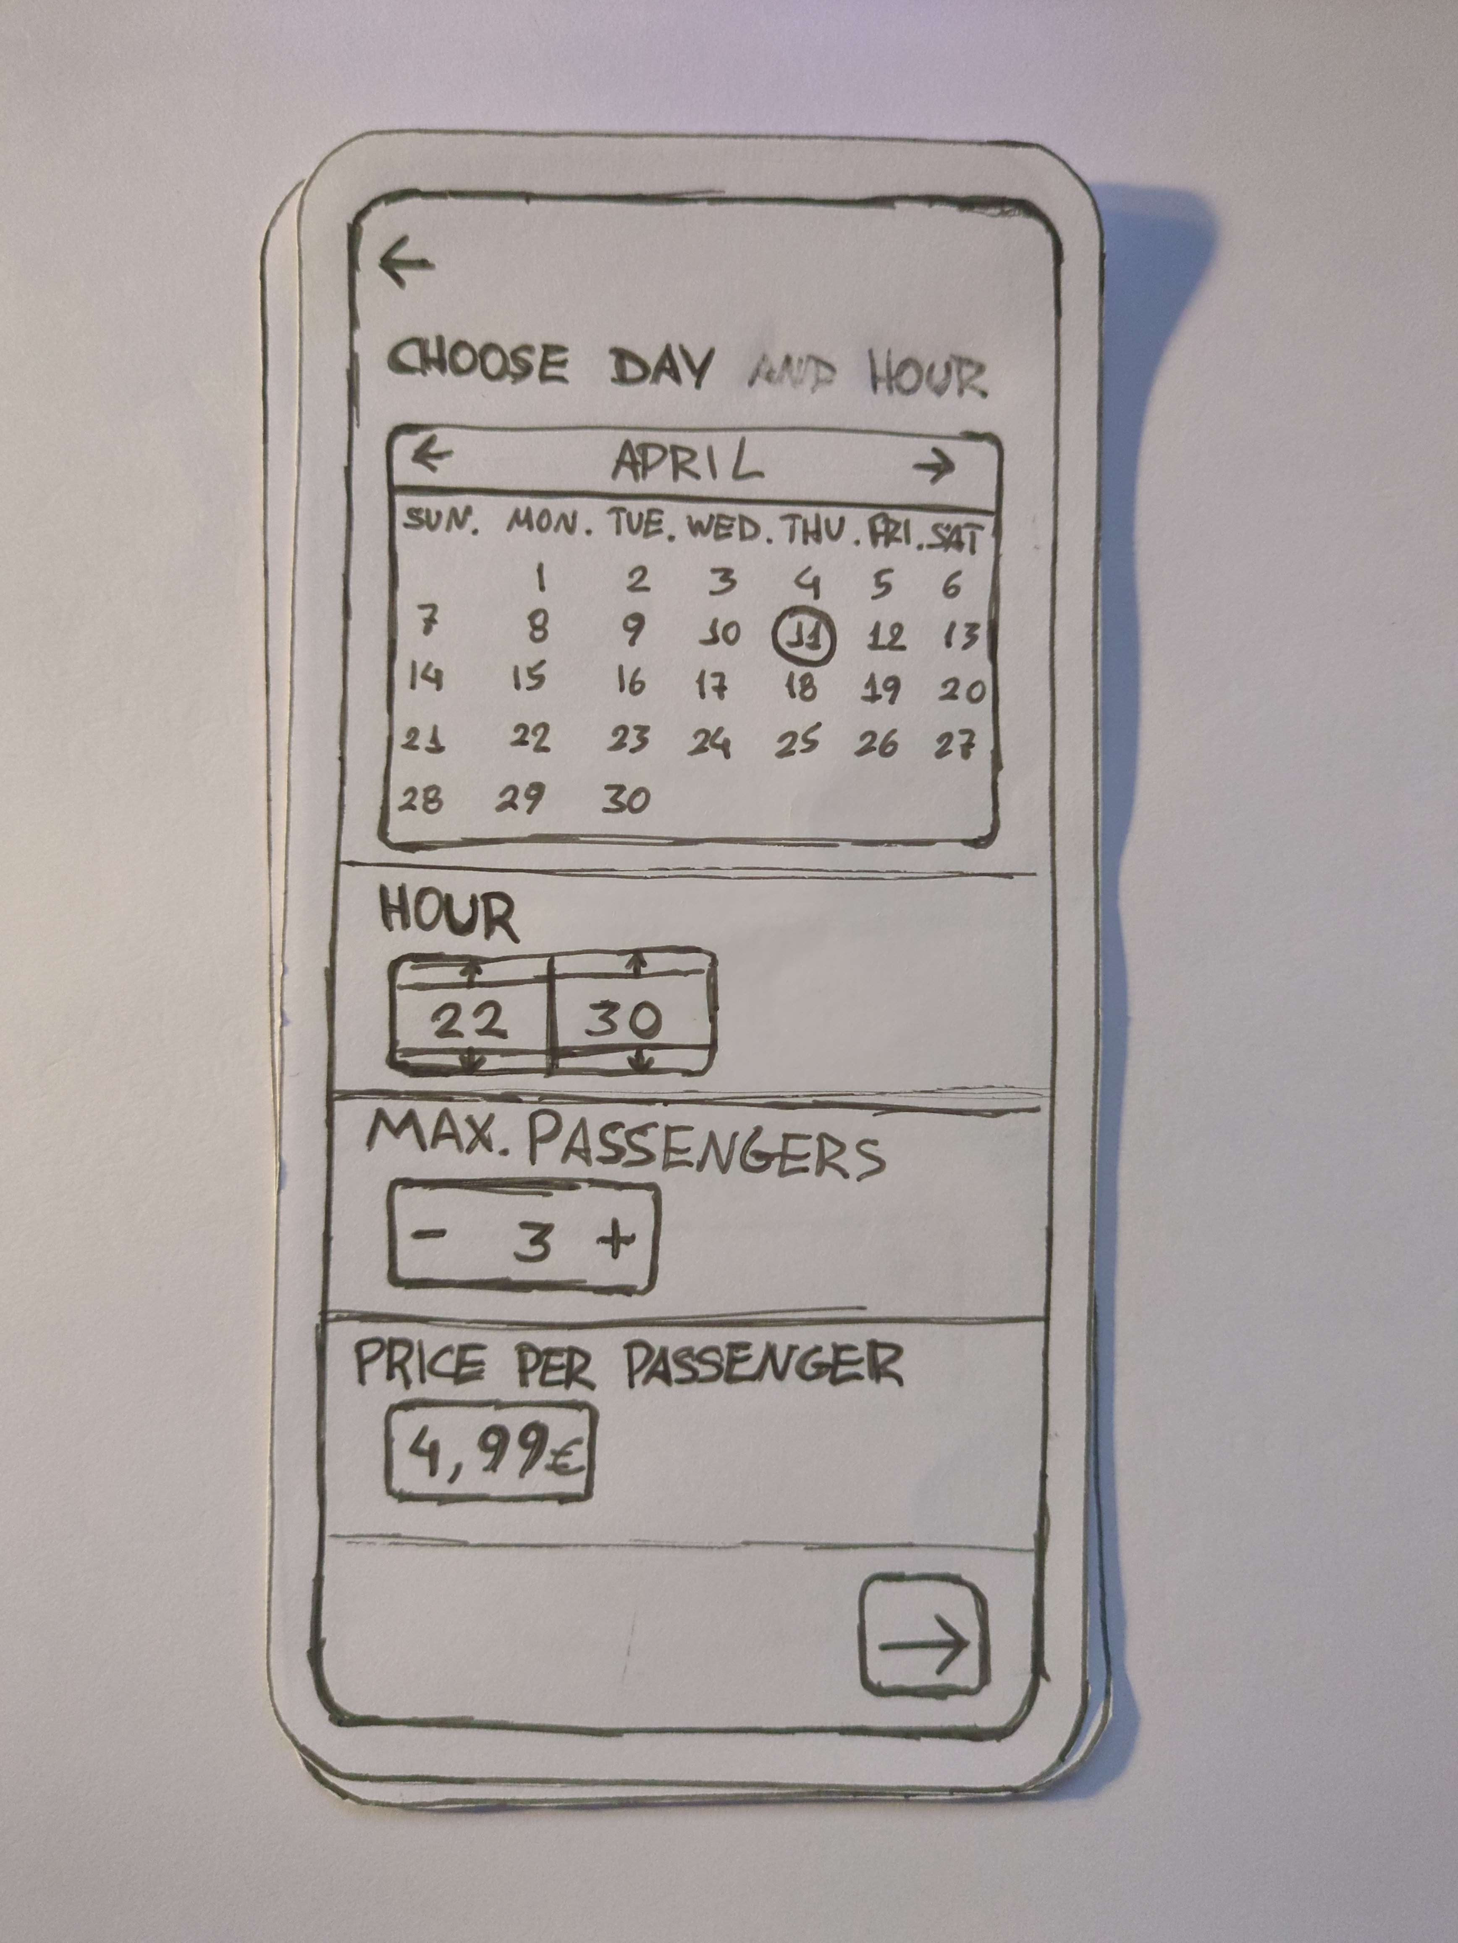
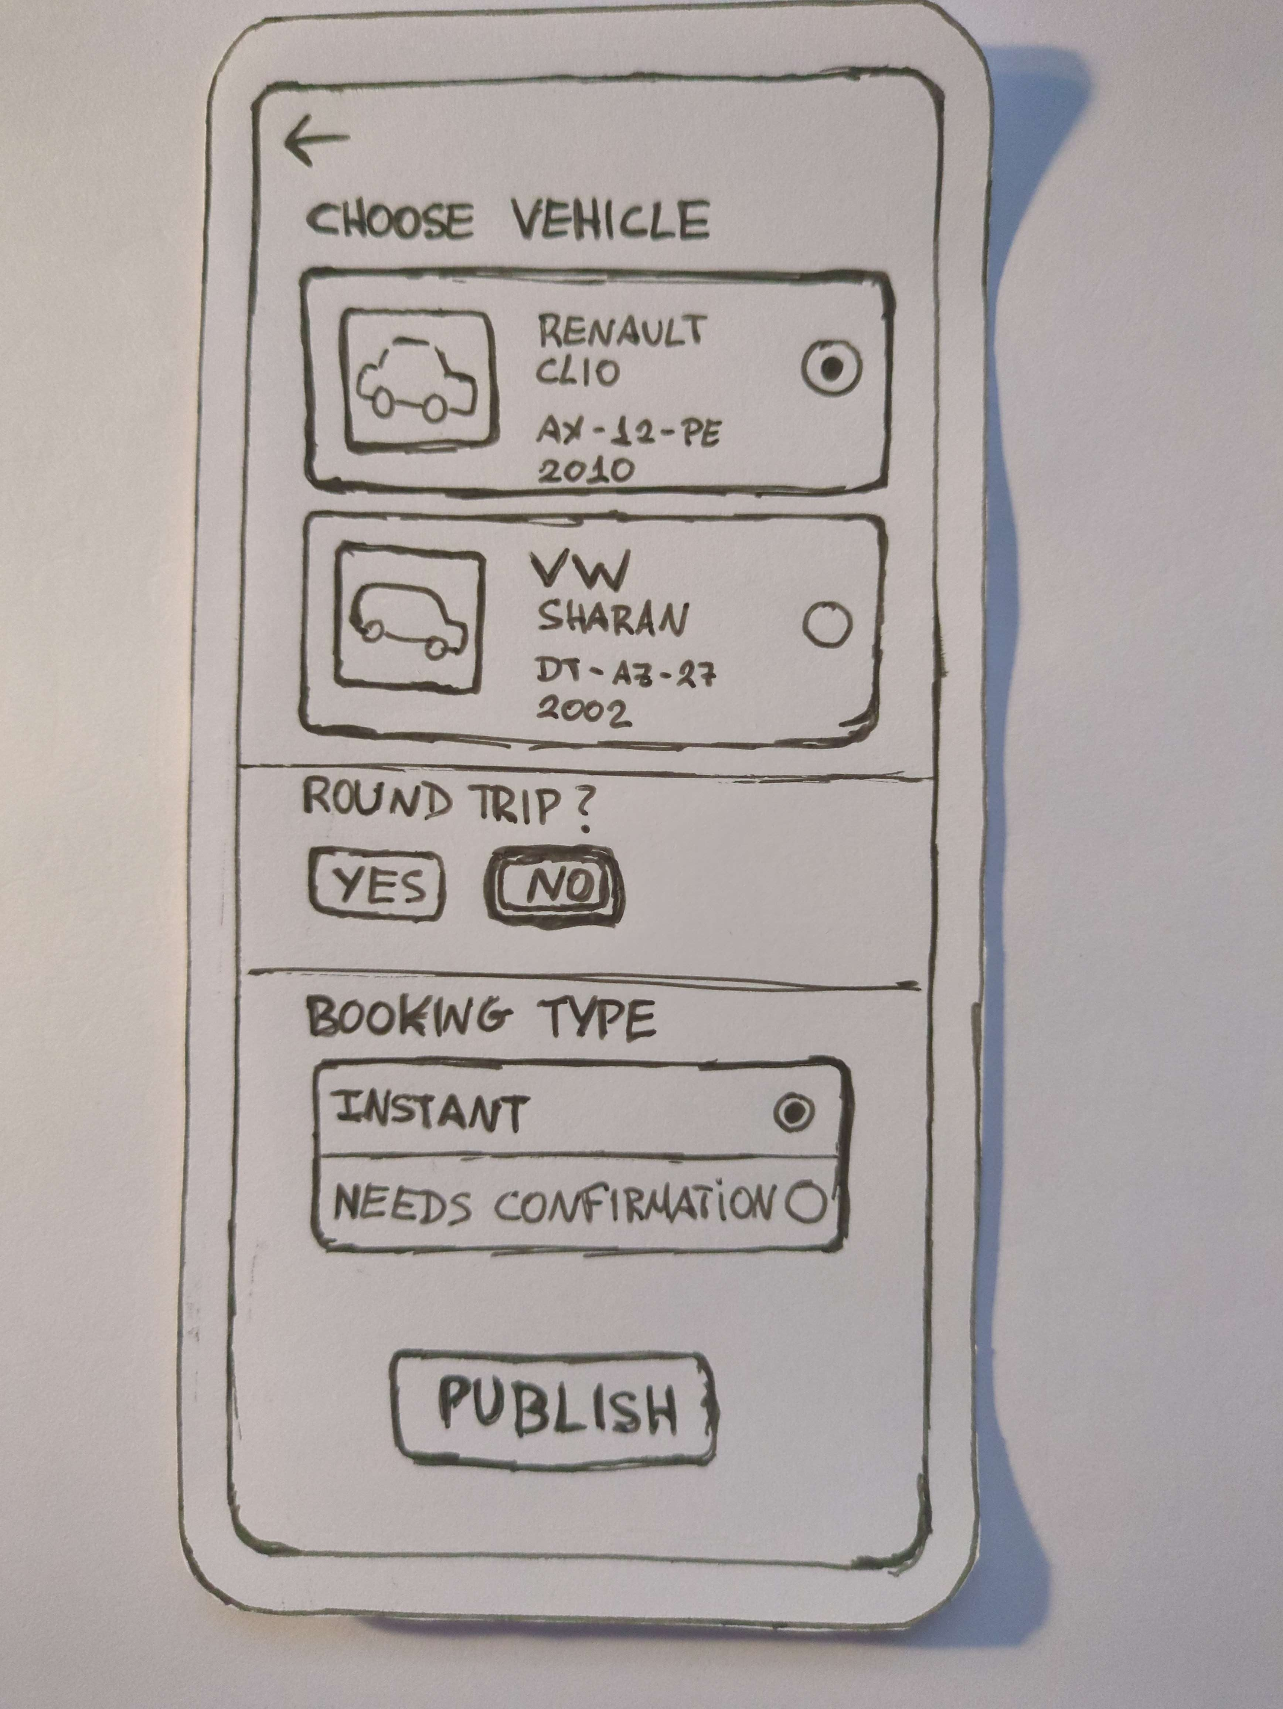
Paper prototype images
10

Slide 11
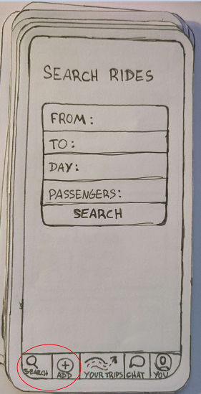
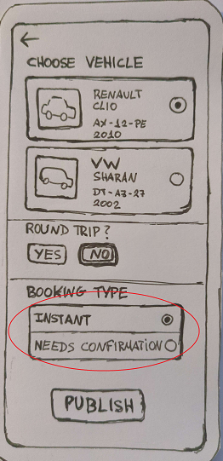
Paper prototype test results
remove search and add ride options from the navigation bar;
put in home page with two buttons for adding and searching a ride;
add help buttons for some options such as instant booking or after confirmation;
11

Slide 12
Main issues during the project
01
02
03
Map
Layout
Live Info
Difficulty using free APIs;
Adjustments to the positioning of buttons, maps, calendar and text;
Transition of travel information between pages;Live itinerary after choosing map positions
12

Slide 13
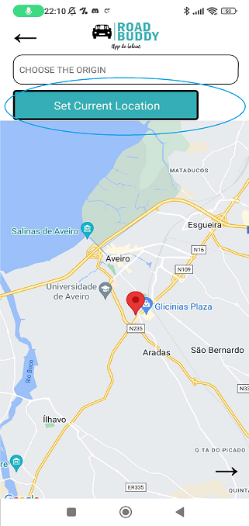
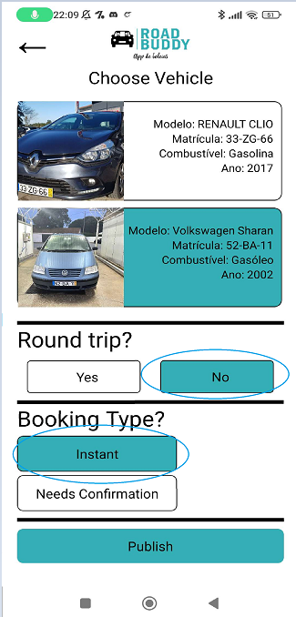
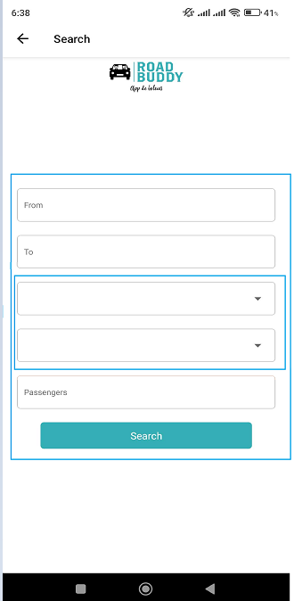
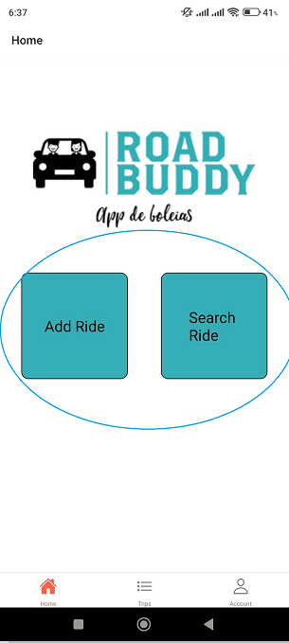
Usability test results – Influence in the final prototype
Homepage Buttons
Search fields
Set current location
Selection feedback
13

Slide 14
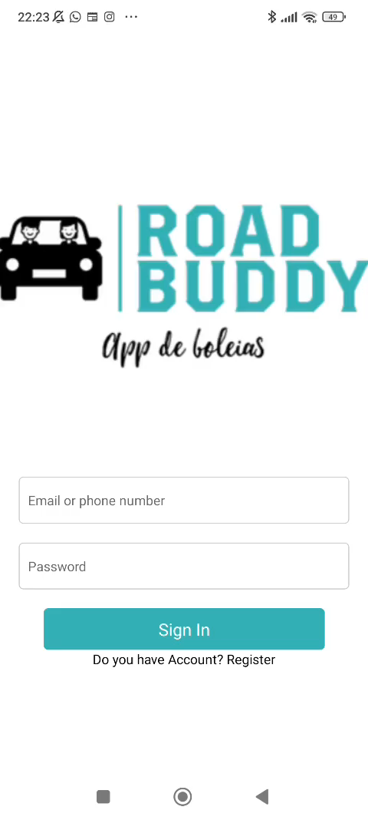
Demo
https://youtu.be/pwRNVYHd468
14

Slide 15
Conclusions
We conclude that usability tests are important because they help developers (in this case us) to identify possible problems, improve the user experience (by receiving feedback from users, in this case it was our classmates) and consequent increase in user satisfaction of our application.
Usability Tests
Prototype
Users
Guilherme Duarte, 107766 ​(33,3 %)
André Rodrigues, 108412​ (33,3 %)
João Rodrigues, 108214 (33,3 %)
15
Notes:
Nem sempre aquilo que achamos estar bem é o ideal para os utilizadores alvo da aplicação/sistema, sendo por isso bastante importante realizar testes de usabilidade pois ajudam os desenvolvedores a identificar possíveis problemas, melhorar a experência do utilizador(recebendo feedback dos utilizadores neste caso foram os nossos colegas de turma), a reduzir os custos numa visão mais empresarial e consequente aumento da satisfação dos utilizadores.
Comentário de um dos questionários "Aplicação simples e intuitiva, de fácil utilização, o que facilita a navegação pelos diferentes menus. Falta feedback na escolha de opções da viagem adicionada."

